Slide 1

The Heartbleed Bug
Serge Borso
serge@sergeborso.com

Slide 2
On the docket
Intro
What is the Heartbleed bug?
Why do we care?
How does it work?
Why does it matter?
What is the impact?
Q and A
Closing

Slide 3

Introduction ~ Serge Borso
Background: Jurassic park (1993)
Had the pleasure to work on fun things like biometrics, online banking security, penetration testing…
Sr. Security Engineer/ Lead Penetration Tester
Mentor with the SANS institute
Lots of experience with vulnerabilities
Multiple letters behind name

Slide 4
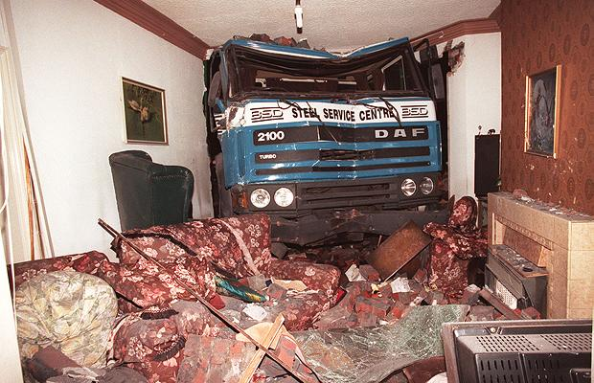
What say you?
Gauge audience – help me tailor the message
~Interaction~ Ask questions!
Security professionals?
Any developers?
Managers?
Impacted parties?
Have FUN!!

Slide 5
What is the Heartbleed bug?
A bug in OpenSSL’s heartbeat extension
CVE-2014-0160 (Common vulnerabilities and exposures) – dictionary for public infosec vulns
Called Heartbleed due to heartbeat extension
The issue is with OpenSSL’s implementation of the heartbeat extension (not SSL in general)
Discovered by Riku, Antti and Matti (Codenomicon) and Neel Mehta (Google)
Published Monday April 7th

Slide 6
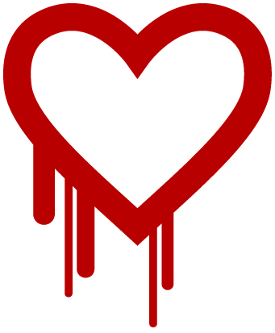
Interesting fact – 0day
Public knowledge as of Monday 4-7-2014
But when was it really discovered?

Slide 7
Answer:
    http://heartbleed.com/
    Domain Name: HEARTBLEED.COM
    Registrar WHOIS Server: whois.godaddy.com
    Registrar URL: http://www.godaddy.com
    Update Date: 2014-04-05 15:13:33
    Creation Date: 2014-04-05 15:13:33
Domain was created on Saturday 4-5-2014
By “codenomicon” out of Oulu Finland
“We fixed this vulnerability last week before it was made public” - CloudFlare on 4-7-2014

Slide 8
When did you hear about it?
I heard about it Monday with the rest of the public
I personally have two different “paid” advanced warning methods
Still found out about it Monday 4-7-2014

Slide 9
How long has OpenSSL been vulnerable
Since the 2012 March 14th release of version 1.0.1
OpenSSL 1.0.1 through 1.0.1f ARE vulnerable
OpenSSL 1.0.1g NOT vulnerable
OpenSSL 1.0.0 branch NOT vulnerable
OpenSSL 0.9.8 branch NOT vulnerable

Slide 10
What is the Risk?
Zero-day attacks occur during the vulnerability window that exists in the time between when vulnerability is first exploited and when software developers start to develop and publish a counter to that threat. – wikipedia
Not a zero-day anymore as the patch has been released
Still needs to be pushed out however on some platforms and applied

Slide 11
Note about zer0day(s)
“This bug fix is a successful example of what is called responsible disclosure. Instead of disclosing the vulnerability to the public right away, the people notified of the problem tracked down the appropriate stakeholders and gave them a chance to fix the vulnerability before it went public.” - cloudflare

Slide 12

Risk part two:
Allows anyone to trivially and secretly* extract:
  HTTPS banking information
  VPN traffic
  Passwords
  Authentication cookies
  Private keys
  And more ☺

Slide 13
Risk part three:
Affects about 500,000, or 17.5 per cent, of “trusted” HTTPS websites
*May be little risk depending on scenario*
The risk is actually huge for some companies
And this is why:

Slide 14
64k

Slide 15

What happens when exploited?
64k of memory gets dumped
  Per request
I dumped 12GB overnight with a modest internet connection
I wrote a script…

Slide 16
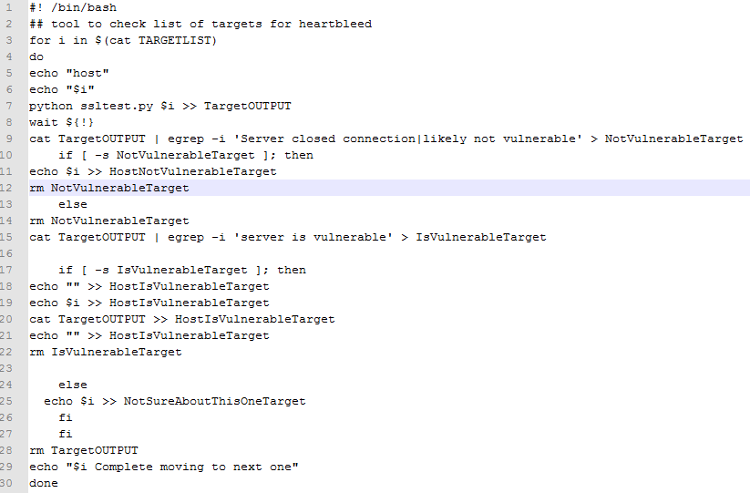

Slide 17
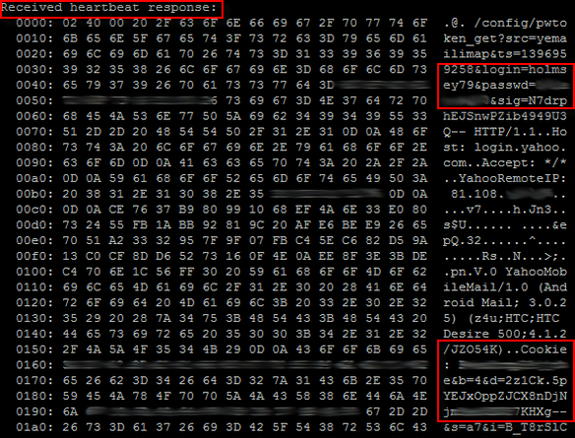
What gets dumped? Show me ☺

Slide 18
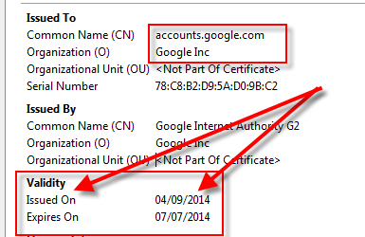
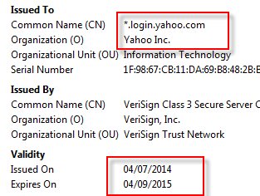
How serious is it?

Slide 19
Really?
CloudFlare launched its own “heartbleed challenge”
Not only did Heartbleed leak private session information (such as cookies and other data that SSL should have been protecting)
But the crown jewels of an HTTPS web server were also vulnerable: the private SSL keys were accessible through Heartbleed messages

Slide 20

Their facial expressions say it all:

Slide 21

Why do we care?
Because we are caring people!
  Remotely exploitable
  Easy to do (with a script)
  Significant implications/exposure
  Millions of targets are/were vulnerable
Targets were exposure for over two years
Essentially no logging for this
Significant aftermath
  Sensitive data leaked…

Slide 22
Caring…
For some of us, its our job
Most of us interact with impacted sites
Headache to reset passwords
It’s a two-way street (client side exploit)
End-users (us) are the victims since its our information that is at risk as much as the organization with the vulnerable webservice
*Necessary to REVOKE and RE-ISSUE SSL certificates

Slide 23
Note – How can you easily tell?
How do you know if your online banking website for example is/was vulnerable?
IS it? https://www.ssllabs.com/ssltest/

Slide 24
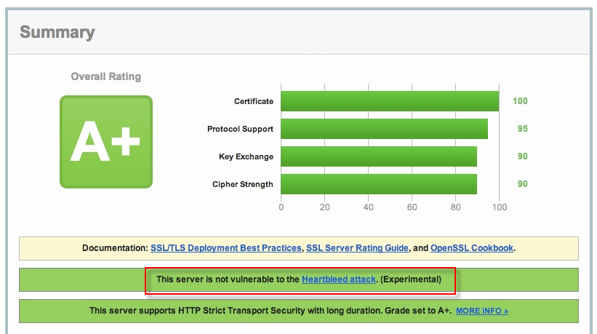
Awesome tool – anyone can use

Slide 25
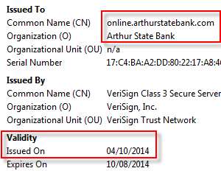
Was it vulnerable though?
Ideally you would have been notified
Check the issue date of the SSL certificate like the previous Google and Yahoo! examples

Slide 26
Note about Microsoft Windows
Proprietary SSL/TLS implementation
Does not use OpenSSL
This means IIS sites are not impacted*

Slide 27

What is OpenSSL?
It’s software/code
Open-source implementation of the SSL and TLS protocols
It’s a suite of tools (sweet tools, very useful)
Written in C
Implements basic cryptographic functions
Started in 1998
The entire group consists of 11 members, of which 10 are volunteers

Slide 28
How does the exploit work?
Missing bounds check before a memcpy() call that uses non-sanitized user input as the length parameter. An attacker can trick OpenSSL into allocating a 64KB buffer, copy more bytes than is necessary into the buffer, send that buffer back, and thus leak the contents of the victim's memory, 64KB at a time.

Slide 29

No really, how does it work?
Time to fire up a virtual development environment and get our hands dirty
VM is up and running, lets check the OpenSSL version:
OpenSSL 1.0.1 through 1.0.1f ARE vulnerable

Slide 30

Webserver and SSL
Quick install of nginx
  Never heard of it?
Using OpenSSL to generate a 2048 bit RSA private key:

Slide 31
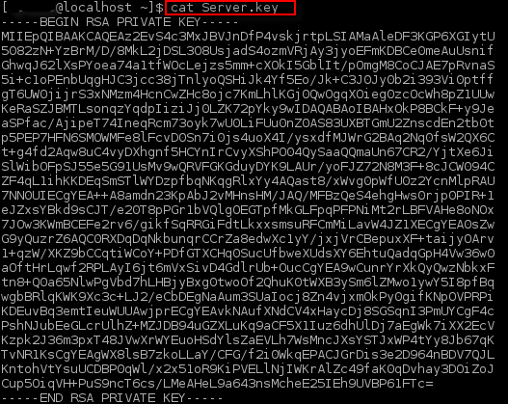
Here is the key:

Slide 32
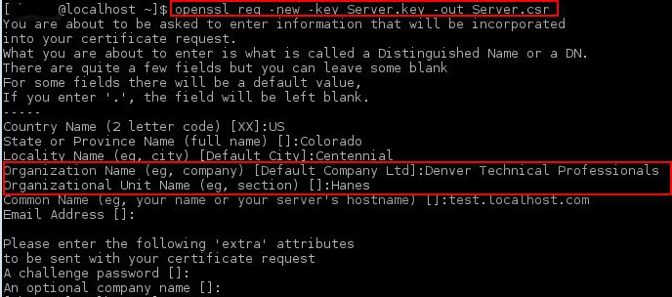
Certificate Signing Request:

Slide 33
Generation of self-signed certificate

Slide 34
Install the Private key and certificate
Using nginx as webserver
Just a matter of copying the key and certificate
Tell the webserver where to look for each and to use SSL (bind to port 443)
Start the webserver next
Default webpage comes up, verify the certificate:

Slide 35
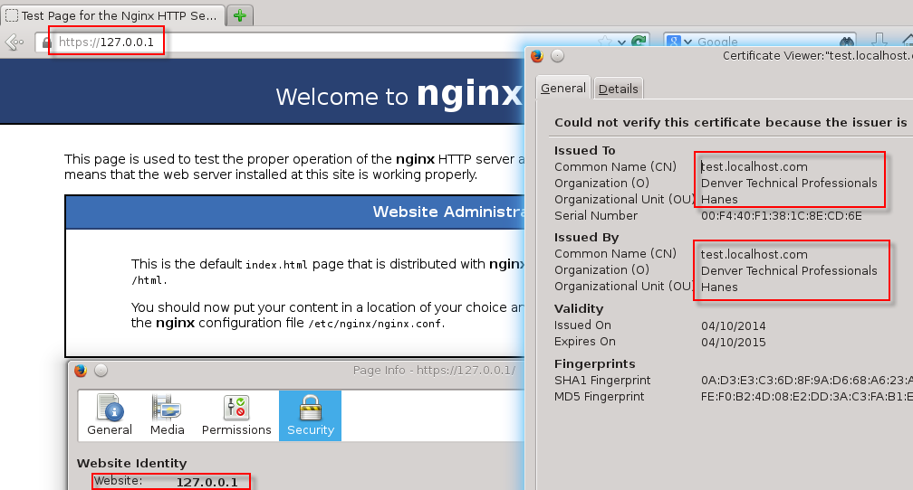

Slide 36
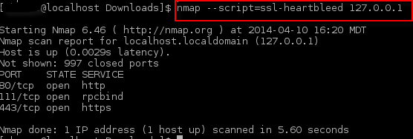
Server is up – time to exploit
Using nmap for quick demo
No dice! Exploit did not work

Slide 37

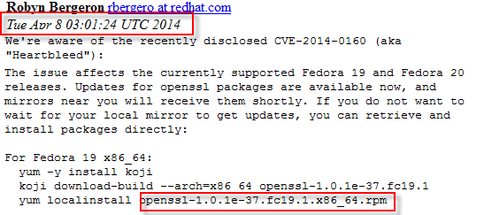
Lets check openssl version again

Slide 38
That was fast
The issue was already patched and my system was up to date
But that’s no fun!
Downgrade…
Re-launch exploit
Dump 64k of server memory

Slide 39
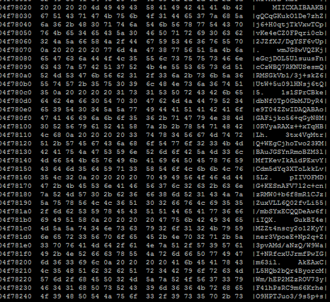
Memory dump

Slide 40
What is actually happening?
Allocated memory is at risk
Since the keys on the webserver are in memory they can be extracted
Depends on where in memory they are
Lets see what it looks like…

Slide 41
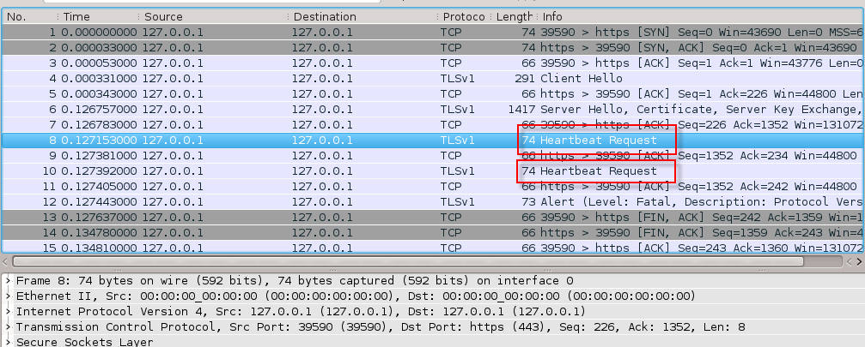
What is happening visual

Slide 42
Breakdown
TCP three-way handshake (syn, syn-ack, ack)
TLS client hello and negotiation with server
Encrypted channel has been established
Next comes the heartbeat Request
Remember, the heartbeat’s intended use was to provide keep-alive functionality without renegotiation
Basically keep the TLS session alive even when no information is being transmitted

Slide 43
Heartbeat
Message request
Machine A sends request data to Machine B
Machine B sends response back to Machine A
The attack works by sending a heartbeat request crafted such that the malicious request is only 1byte worth of data (for instance) but the message SAYS its 65536 bytes
The vulnerable OpenSSL library fails to check the actual size, instead believing the stated size

Slide 44
The issue
OpenSSL does not validate the message size
Instead it blindly accepts the included value which is set by the attacker
OpenSSL then references the memory location where the 1byte payload was stored
Then dumps 65535 more bytes of memory in addition to the 1byte payload
65536 = 64k (1000 vs 1024)
This is where the 64k of memory comes from

Slide 45
How to fix
The fix is to protect against the way OpenSSL memory is allocated so that memory allocated for sensitive data (like private keys) is kept far away from the memory buffers used for messages
Validate the user provided payload size
Already fixed

Slide 46
Impacted sites + many more
Facebook
Instagram
Yahoo!
Google
Pinterest
Tumblr
Amazon web services
Godaddy
Netflix…

Slide 47

What to do now?
Reset passwords
Update systems
Revoke and re-issues SSL certificates
The usual…

Slide 48
What does this mean?
The little lock doesn’t mean “secure”
Having unique passwords for *everything* is something I advocate
Get a password safe to make that easy
Three days ago there was another zero-day for Internet Explorer
Life goes on
This is what some of us get paid for..
Job security?

Slide 49
Conclusions
Draw your own
Did the NSA use this?
  I don’t get the impression that they knew about it beforehand
How big of a deal was this?
  Depends on your circumstances
Will something like this happen again
  Yes ☺
Thanks for your time!

Slide 50

Q and
Possibly A

Slide 51

References
http://heartbleed.com/
http://blog.cloudflare.com/staying-ahead-of-openssl-vulnerabilities
http://blog.cloudflare.com/searching-for-the-prime-suspect-how-heartbleed-leaked-private-keys
http://blog.cloudflare.com/the-heartbleed-aftermath-all-cloudflare-certificates-revoked-and-reissued
http://blog.existentialize.com/diagnosis-of-the-openssl-heartbleed-bug.html
http://www.lightbluetouchpaper.org/2014/04/25/heartbleed-and-rsa-private-keys/
http://www.siemens.com/innovation/pool/de/forschungsfelder/siemens_security_advisory_ssa-635659.pdf
https://isc.sans.edu/forums/diary/Testing+your+website+for+the+heartbleed+vulnerability+with+nmap/17991
https://www.schneier.com/blog/archives/2014/04/heartbleed.html
http://www.theregister.co.uk/2014/04/09/heartbleed_explained/
https://github.com/rapid7/metasploit-framework/blob/master/modules/auxiliary/scanner/ssl/openssl_heartbleed.rb
https://blog.ipredator.se/2014/04/how-to-test-if-your-openssl-heartbleeds.html
https://www.ssllabs.com/ssltest/
http://www.cnet.com/how-to/which-sites-have-patched-the-heartbleed-bug/

